Slide 1
Online examination SYSTEM
Mohammed Latif Siddiq,1505069
Nadia Anjum,1505085

Slide 2
Requirement Analysis
What is the problem?
[Text]
Who has this problem?
[Text]
Why should this problem be solved?
[Text]
How will I know this problem has been solved?
[Text]

Slide 3
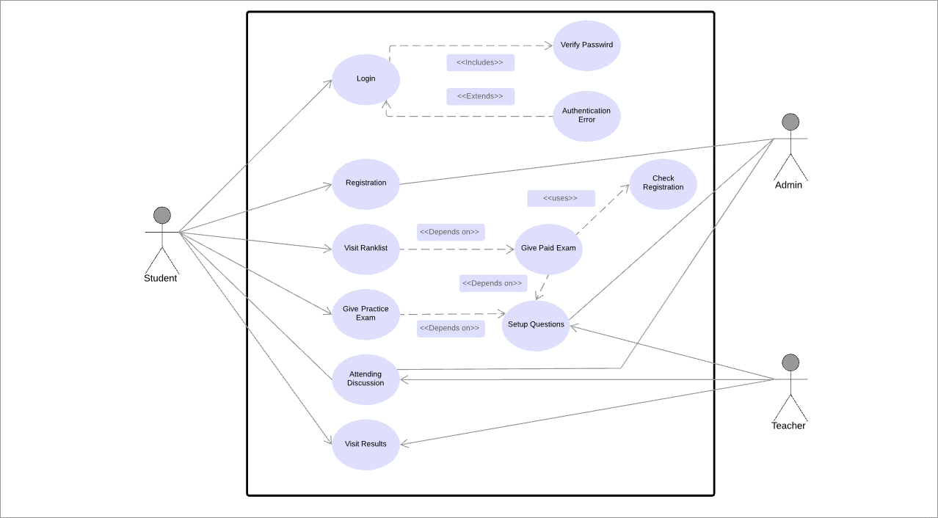
Use case DIAGRAM

